Slide 1
CMSC204
Kartchner
V(StateGraph) = {Oregon, Alaska, Texas, Hawaii, Vermont, NewYork, California}
E(StateGraph) = {(Alaska, Oregon), (Hawaii, Alaska), (Hawaii, Texas), (Texas, Hawaii), (Hawaii, California), (Hawaii, New York), (Texas, Vermont), (Vermont, California), (Vermont, Alaska)}
1. Draw the StateGraph
Alaska
Oregon
Hawaii
Texas
New York
Vermont
California

Slide 2
a. Show the adjacency matrix that would describe the edges in the graph. Store the vertices in alphabetical order
States
3. b. Show the adjacency lists
that would describe the edges in the graph

Slide 3
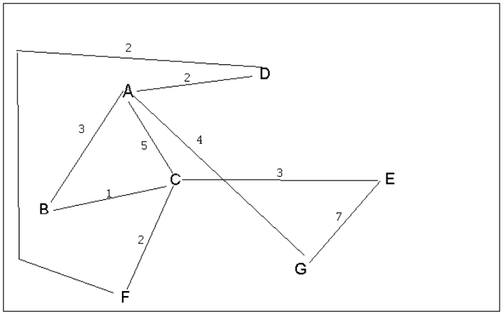
4 a. Which of the following lists the graph nodes in depth first order beginning with E?
A) E, G, F, C, D, B, A
B) G, A, E, C, B, F, D
C) E, G, A, D, F, C, B
D) E, C, F, B, A, D, G
4 b. Which of the following lists the graph nodes in breadth first order beginning at F?
A) F, C, D, A, B, E, G
B) F, D, C, A, B, C, G
C) F, C, D, B, G, A, E
D) a, b, and c are all breadth first traversals

Slide 4
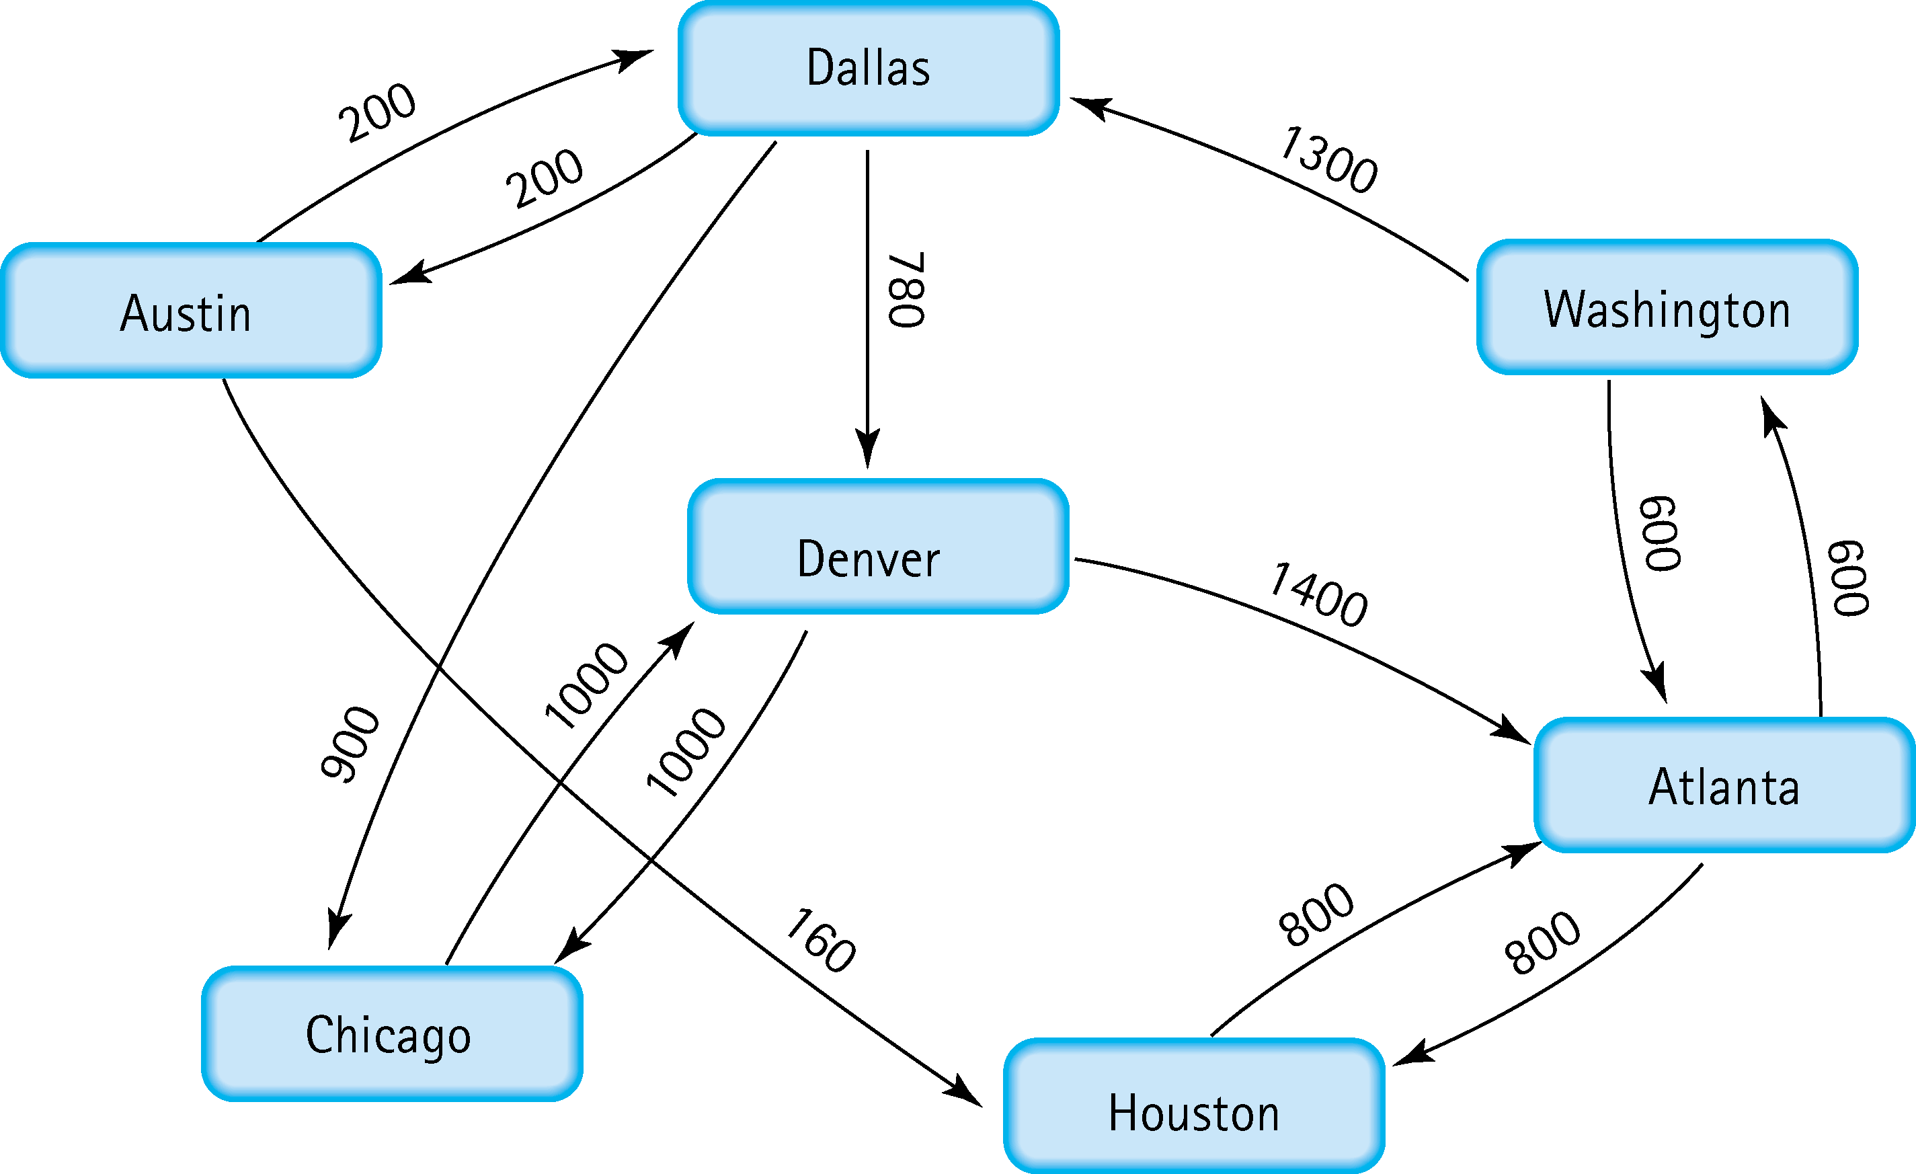
5. Find the shortest distance from Atlanta to every other city
Washington: 600
Houston: 800
Dallas: 1900 (Atlanta -> Washington)
Denver: 2680 (Atlanta -> Washington -> Dallas)
Austin: 2100 (Atlanta -> Washington -> Dallas)
Chicago: 2800 (Atlanta -> Washington -> Dallas)

Slide 5
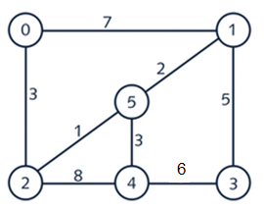
6. Find the minimal spanning tree using Prim’s algorithm. Use
0 as the source vertex . Show the steps.
0 -> 2 -> 5
Path from 2 to 5 is shorter than from 2 to 4.
0 -> 2 -> 5 -> 1
Path from 5 to 1 is shorter than from 5 to 4.
0 -> 2 -> 5 -> 1 -> 4
Path from 5 to 4 is shorter than from 5 to 1.
0 -> 2 -> 5 -> 1 -> 4 -> 3
Only 3 is remaining

Slide 6
7. Find the minimal spanning tree using Kruskal’s algorithm.
Show the weights in order and the steps.
0
1
0
2
1
1
5
3
1
5
5
2
4
3
2
4
3
0
2
1
5
0
2
1
1
3
1
5
5
2
4
3
6
2
4
3
0
2
1
3
1
5
2
4
3
Total Weight: 17

Slide 7
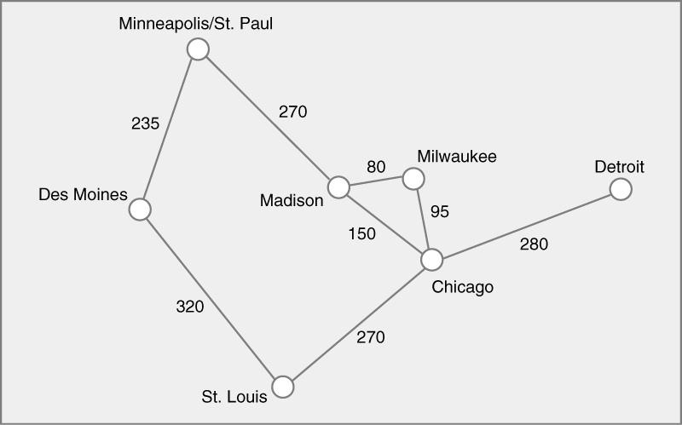
8. Find the minimal spanning tree using the algorithm you prefer. Use
Minneapolis/St. Paul as the source vertex
Minneapolis/St. Paul
235
270
Milwaukee
Detroit
80
95
Des Moines
Madison
280
Chicago
270
St. Louis

Slide 8
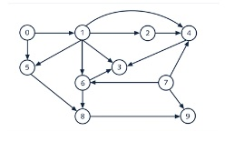
9. List the nodes of the graph in a breadth first topological ordering. Show the
steps using arrays predCount, topologicalOrder and a queue
Queue
Array
1 | 5
0
Queue
Array
5 | 2 | 3
0 | 1
Queue
Array
2 | 3 | 8
0 | 1 | 5
Queue
Array
3 | 8 | 6 | 4
0 | 1 | 5 | 2
Queue
Array
8
0 | 1 | 5 | 2 | 3 | 6 | 4
Queue
Array
9
0 | 1 | 5 | 2 | 3 | 6 | 4 | 8
Queue
Array
7
0 | 1 | 5 | 2 | 3 | 6 | 4 | 8 | 9
Queue
Array
0 | 1 | 5 | 2 | 3 | 6 | 4 | 8 | 9 | 7

Slide 9
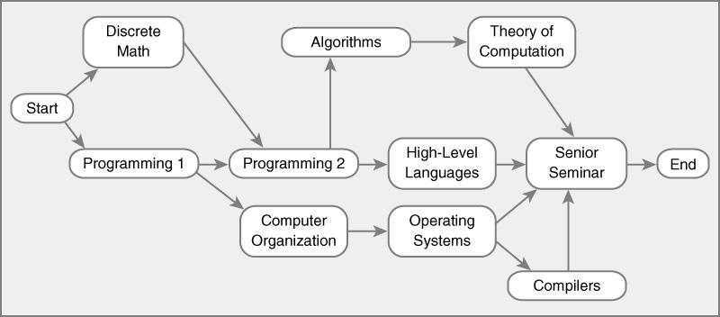
10. List the nodes of the graph in a breadth first topological ordering.
Queue
Array
Dis.Math | Prog 1
Start
Queue
Array
Prog 1 | Prog 2
Start | Dis.Math
Queue
Array
Prog 2 | Comp Org.
Start | Dis. Math
Queue
Array
Comp Org. | Algorithms | HL Lang.
Start | Dis. Math | Prog 2
Queue
Array
Algorithms | HL Lang. | OS
Start | Dis. Math | Prog 2 | Comp Org.

Slide 10
Queue
Array
HL Lang. | OS | Theory of Comp
Start | Dis. Math | Prog 2 | Comp Org. | Algorithms
Queue
Array
OS | Theory of Comp | Senior Seminar
Start | Dis. Math | Prog 2 | Comp Org. | Algorithms | HL Lang.
Queue
Array
Theory of Comp | Senior Seminar | Compilers
Start | Dis. Math | Prog 2 | Comp Org. | Algorithms | HL Lang. | OS
Queue
Array
Start | Dis. Math | Prog 2 | Comp Org. | Algorithms | HL Lang. | OS | Theory of Comp | Senior Seminar | Compilers

